Slide 1

Alexander Karaneichev
alexander.karanichev@outloook.com
Petko Ivanov
Petko.Ivanov@outlook.com
Viktor Nikolov
Viktor.nikolov@outlook.com
Marin Marinov
Marin.marinov@outlook.com

Slide 2

Our story
Ever since we met. We've been traveling all across the world touring every country.
And over and over we have met the same difficulties of seeking flights, tours and good tourist attractions.
Thus we have decided to team up and make the perfect tourist guide and flight planner.

Slide 3
Why our app ?
The quality of the market in Bulgaria isn’t set so high, so with our app we aim to set the bar higher than ever before.
Our app provides a lot of utility and convenience for our customers.

Slide 4
The pains of manual search
Searching for flights, tours and worthwhile tourist attractions. Is a tedious and exhausting process that you may easily save yourselves and enjoy your vacation whit our app.

Slide 5
The simple solution our app offers to you
Our application is specially created to make the ticket reservation and searching for travel information much easier for you, our customers, saving you a lot of time and efforts.

Slide 6
The Market
Total Available Market (TAM)
Serviceable Available Market (SAM)
Serviceable Obtainable Market (SOM)
Total Available Market (TAM): The EMEA region market is worth 644 billion U.S. dollars.
Serviceable Available Market (SAM): the european sector that we plan to tap into composes around 2/3's of the EMEA region
Serviceable Obtainable Market (SOM): We believe that we can capture roughly half of the SAM marketshare leaving us with profits of 53.5 billion U.S. dollars.

Slide 7
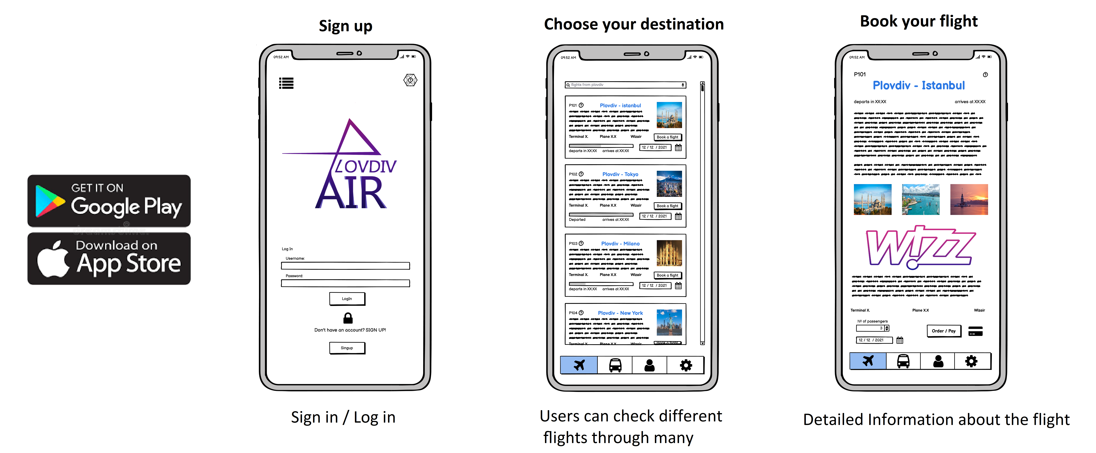
Our product

Slide 8
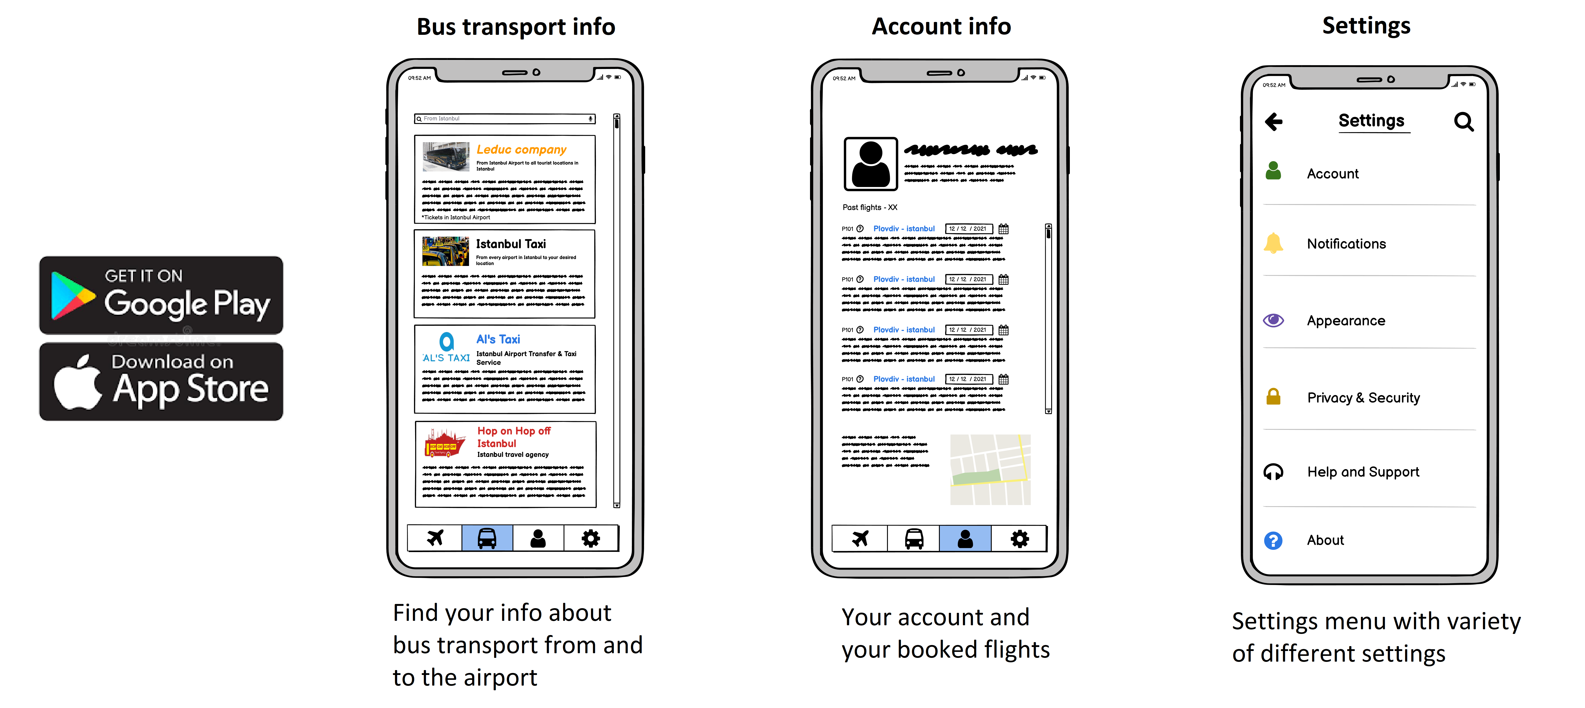
Our Product

Slide 9
The Product Roadmap
IDEA
CONCEPT
TESTING
RELEASE
Product ideation:
Materials, features, purposes, alternatives
Product ideation continued
Concept production
and testing:
Test comfort, durability, functionality, fashon
Product testing continued:
Reiterate, optimize,
finalize
Product concept:
Designs? Features?
Target Market?
Open pre-order,
release marketing campaign, prepare
for retail launch
Market analysis:
Branding, naming,
campaign planning
Competitor Reserch

Slide 10
Our vision
We plan to create a simple app that will help our customers to explore the world By offering them good flight deals, tourist hotspots and tour guides.

Slide 11
Our monetization plan
Unit price = Free (0 BGN)
Premium account price: 5 BGN
In our app we will have ads from our different sponsors. However, if someone wants to remove the ads they can simply buy the full version of our application

Slide 12

Financials and cost
We prospect around 250 000 – 500 000 BGN to produce plovdivair

Slide 13

Funds Being Raised
We have monetary Prospects of:
300,000 - 500,000 BGN per year
From ad revenue.

Slide 14
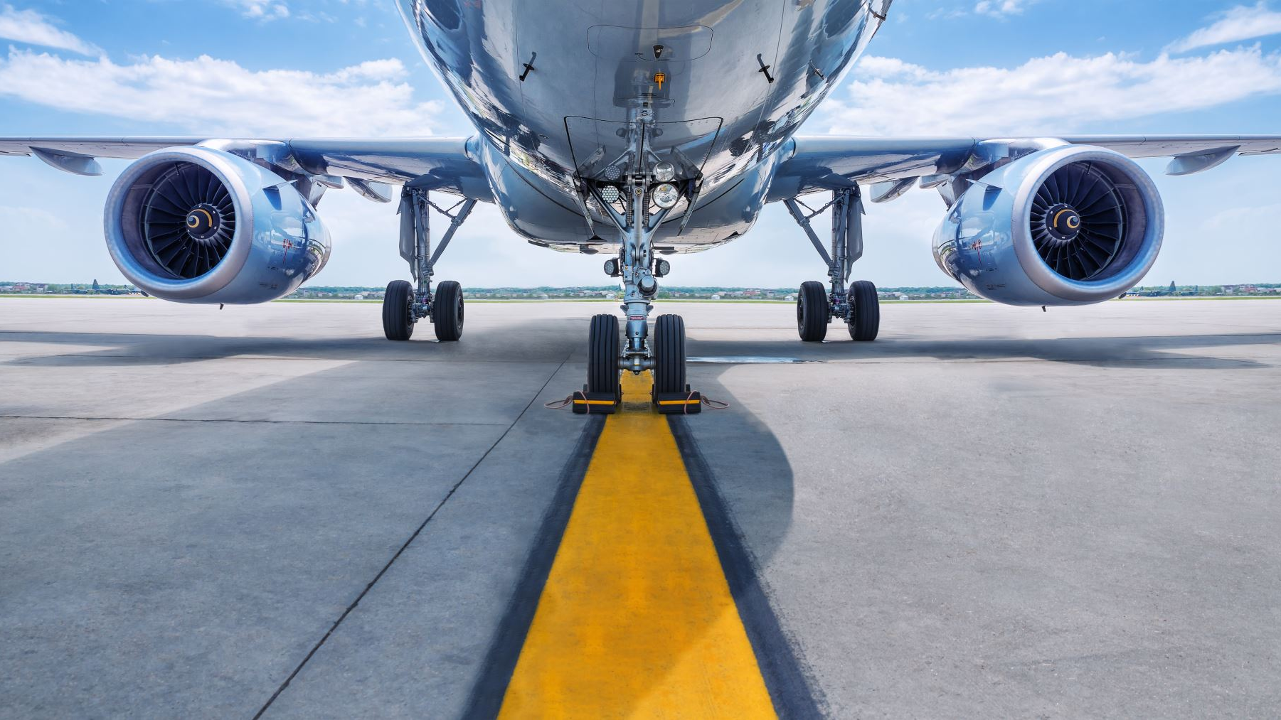
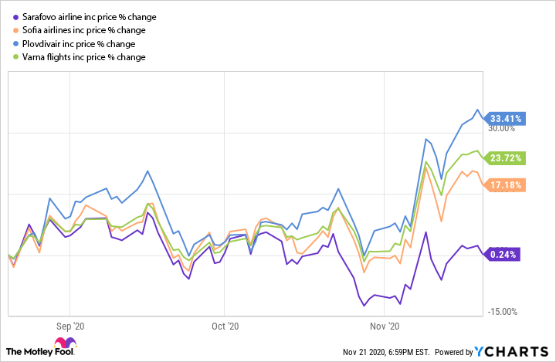
Competition
Sarafovo airlines
Sofia Airport
PlovivAir
Varna Airport

Slide 15

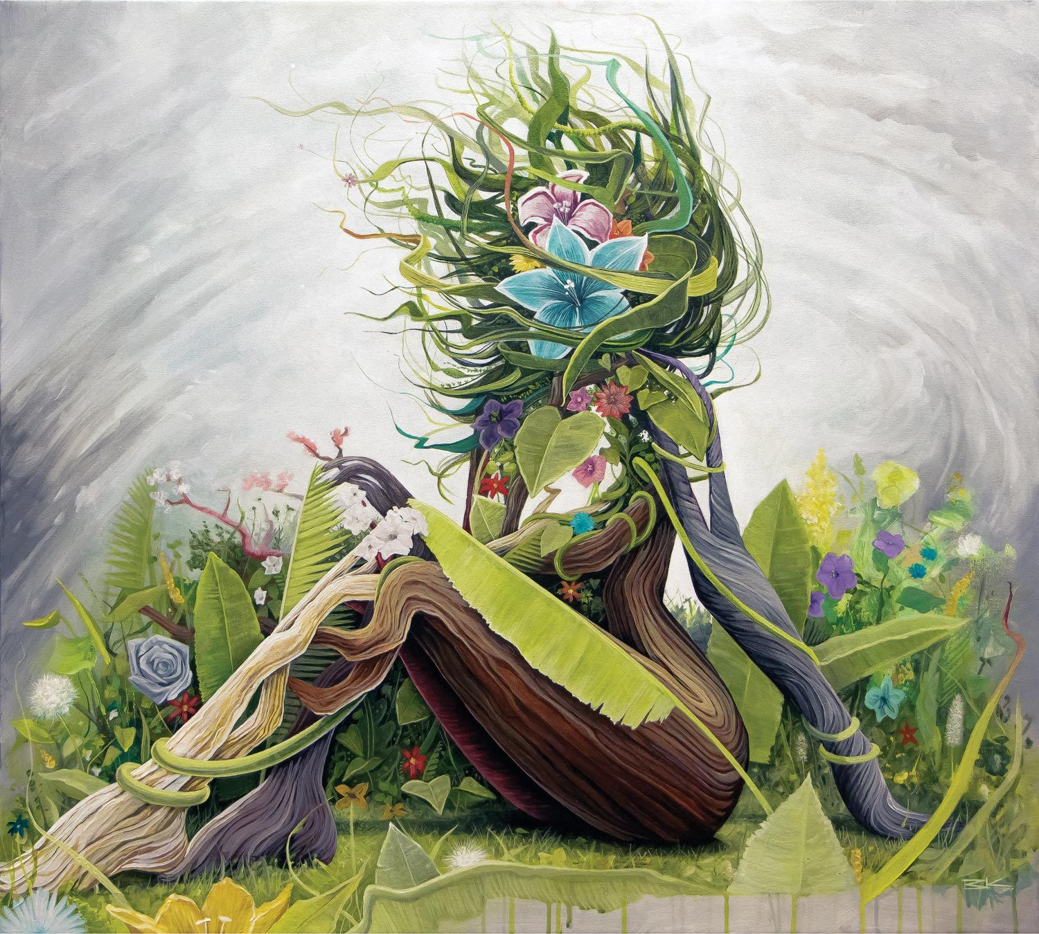
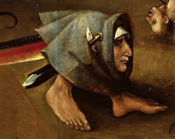

Team Members
Alexander
Karaneichev,
Lead Developer
alexander.karaneichev@outlook.com
089 555 7790
Marin Marinov,
Graphic designer
marin.marinov@outlook.com
089 876 5432
Viktor Nikolov,
User Interface
viktor.nikolov@outlook.com
089 766 5445
Petko Ivanov,
Marketing expert
petko.Ivanov@outlook,.com
089 000 0000

Slide 16
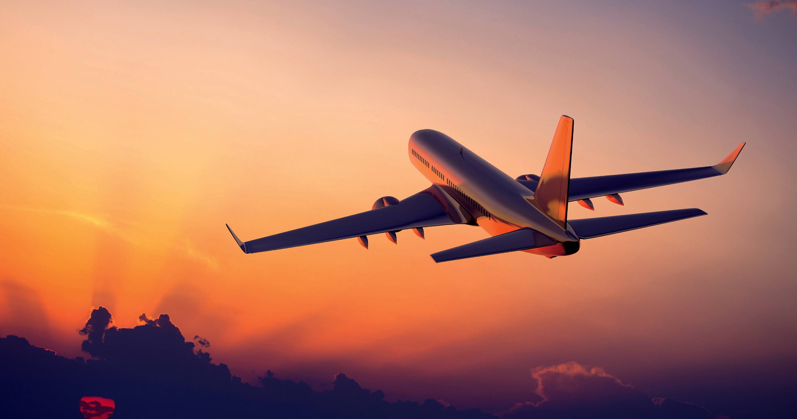
THANK YOU FOR THE ATTENTION!
" The sky awaits you"

